Slide 1


My Autobiography
My name is Leeroy Christopher, and I'm excited to share my journey with you. This is a tale of family, growth, and the lessons life has taught me.
Leeroy

Slide 2

Early Years
1
Birth & Family
Born in Nakuru, Kenya, I was the second of six children. My parents, Evalyne and Musa, provided a loving and supportive home.
2
Childhood Memories
I spent my early years surrounded by my siblings, exploring the town and playing in the streets. We were a close-knit family.
3
Education & Friends
My education began at a local school in Nakuru, where I made lasting friendships that continue to this day.

Slide 3
School Years
Academic Excellence
Extracurricular Activities
Making Friends
I excelled in my studies, particularly in mathematics and science. I enjoyed the challenge and the pursuit of knowledge.
I participated in various extracurricular activities, including sports and music. These activities allowed me to develop teamwork and leadership skills.
School provided opportunities to connect with people from diverse backgrounds. I formed strong bonds with my classmates and teachers.

Slide 4

Discovering My Passion
1
Computer Science
2
Early Projects
My passion for computer science emerged during my teenage years. I was drawn to the logic and problem-solving aspect of programming.
I began developing my skills through personal projects, experimenting with different programming languages and software.
3
Networking & Mentorship
4
Unwavering Determination
I actively sought guidance from experienced professionals, attending workshops and connecting with mentors in the tech industry.
Despite the challenges, my passion for computer science fueled my determination to pursue a career in this field.

Slide 5





Higher Education & Career
University Admission
I received acceptance into a prestigious university program in computer science, a testament to my hard work and dedication.
Academic Success
I thrived in the university environment, consistently performing well in my courses and engaging actively in research projects.
Internship & Job Offers
I secured an internship at a leading tech company, gaining valuable hands-on experience and networking opportunities.
Launching My Career
After graduation, I received multiple job offers, ultimately choosing to work for a company that aligned with my career aspirations.

Slide 6

Professional Growth
Year
Role
Company
Key Accomplishments
2018
Software Engineer
Tech Solutions Inc.
Developed a key feature for a popular software application.
2020
Team Lead
Tech Solutions Inc.
Led a team of engineers to deliver a successful product launch.
2022
Senior Software Architect
Tech Solutions Inc.
Designed and implemented innovative solutions for complex technical challenges.

Slide 7
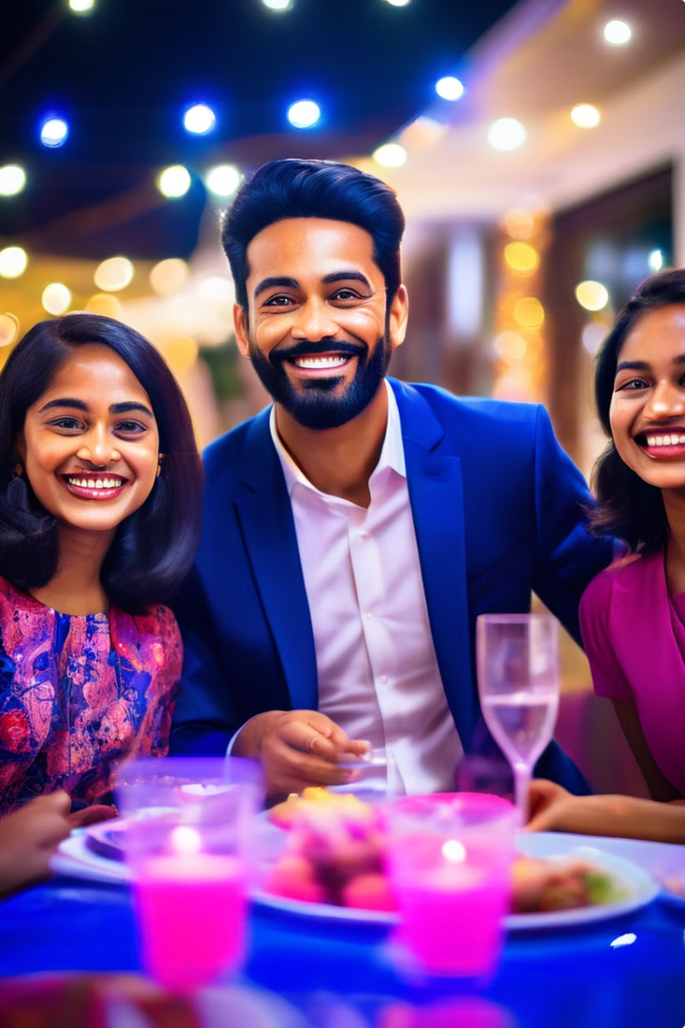
Personal Life
Relationships
Hobbies & Interests
I value my family and friends deeply. Their love and support have been invaluable throughout my journey.
I enjoy reading, exploring new technologies, and spending time with loved ones. These activities bring me joy and balance.
Travel & Adventures
Giving Back
I am an avid traveler, eager to experience different cultures and broaden my perspectives. I have visited several countries, each trip offering unique experiences.
I believe in the importance of giving back to the community. I actively participate in volunteer activities and support causes that resonate with me.

Slide 8





Looking Ahead
Ambitious Goals
Continuous Learning
I have ambitious goals for the future, including contributing to technological advancements and making a positive impact on the world.
I am committed to lifelong learning, constantly seeking new knowledge and skills to enhance my abilities and stay ahead of the curve.
Achieving Success
Community Involvement
I am driven by a desire to achieve success in my career and personal life, while staying true to my values and principles.
I am dedicated to using my skills and resources to make a positive difference in my community and the world at large.

Slide 9

Conclusion
My journey has been filled with challenges and triumphs. I am grateful for the lessons learned and the opportunities that have shaped me into the person I am today. I am excited for what the future holds and eager to continue making a difference in the world.

